Slide 1


Full Stack Flush
Chineze Obi
Darian Hamel
Kaye Mendoza
Mateo DeSousa
Prashant Nigam
Scott Barrett

Slide 2
Our Vision
Our Goal
A gambling web application designed to set a new standard for gambling platforms through its integrated ethical features.
Vision Statement
We strive to improve gambling habits of the overall population.
The Outcome
Provide a safe and healthy gambling environment while still delivering a fun and engaging experience to all users.

Slide 3

Core Features

Slide 4
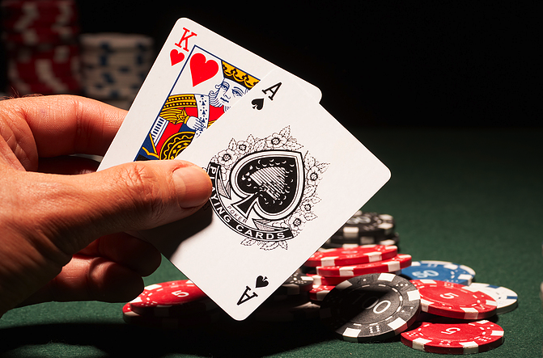
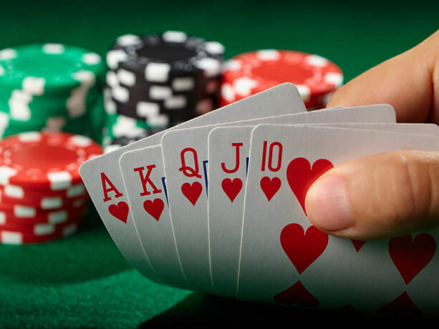
Card Games
Blackjack
Poker
Standard blackjack card game
Notifications for bet amounts
Poker-like minigame
Create the best poker hand (inspired by the game Balatro)

Slide 5


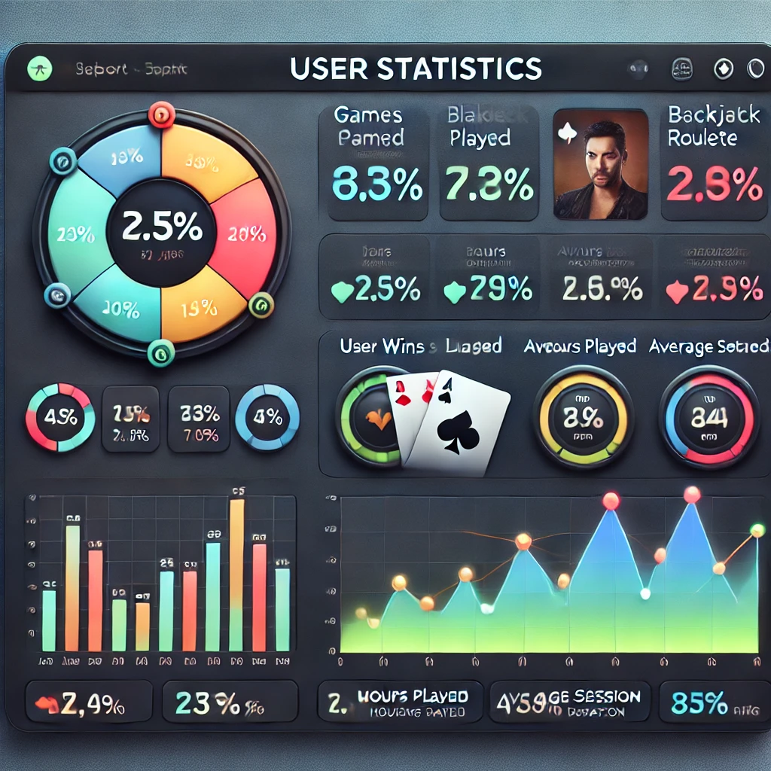
What makes it engaging?
Teaching Fundamentals
Leaderboards
User Stats
Teach users the basics of the games
Provide information on the odds of the games
A leaderboard that compares win/loss ratios against other users
Track win/loss ratio
Transaction history
Days and times visited

Slide 6



Safe Gambling
Remind users to take breaks
Provide warnings, reminders, and useful facts about the dangers of gambling
Educate users
Set time and money limits on gambling
Artificial intelligence gambling habit tracking

Slide 7
References
https://chatgpt.com/share/679695bc-01fc-800d-8eb5-43e02c3b8632
https://www.sigma-orionis.com/gambling-market/ethics-issues-related-to-gambling/
https://chatgpt.com/share/679695e1-faf4-8013-878b-af59d7175b91
https://sl.bing.net/cbfIrusfmay
https://sl.bing.net/eQehuvQgqI0
https://i.gifer.com/8nNh.gif
https://www.freepik.com/icon/leaderboard_11106449
https://crescent.edu/post/the-history-of-blackjack
https://www.gamezy.com/card-games/poker/

